Slide 1




Xamarin training
for Microsoft Services Professionals
Always be shipping

Slide 2
Agenda
Xamarin.UITest
Write your first UI tests
Test suite architecture
Learn how to build a larger test suite
Test Cloud
Test Cloud reports and interpreting results
Submitting tests
DevOps lifecycle
Continuous integration
Build scripts

Slide 3
Xamarin.UITest

Slide 4
UI testing vs. Unit testing
Similarities
Tests should be short and focus on one aspect of the app at a time
Differences
UI testing tests the integration of systems; unit testing tests a single, isolated system
UI testing can’t mock systems easily because of compiled binaries
The system under test (SUT) with UI testing is a behavior or feature of the app
Notes:
Similarities
Tests should be short and test one aspect of the app at a time.
Ideally you only have one assertion per test, which prevents an assertion from "hiding" behind a previous, failing, assertion (resulting in the assertion not being tested).
Differences
UI testing is acceptance or behavior-driven testing. This inherently means we're testing all of the integrations of systems, whereas unit testing tests a single, isolated system (a specific subsystem) without considering any outside involvement.
Can't mock systems the same way as unit tests. With UI testing, we’re dealing with compiled binaries, so this makes mocking systems, like example web services, a bit more difficult but not impossible. This can be done using custom build configurations that conditionally set mocked web services and conditional compilations of binaries.
The system under test (SUT) is a behavior or feature of the application rather than an actual system of your application. (for example, the login/authentication or sign out feature)

Slide 5
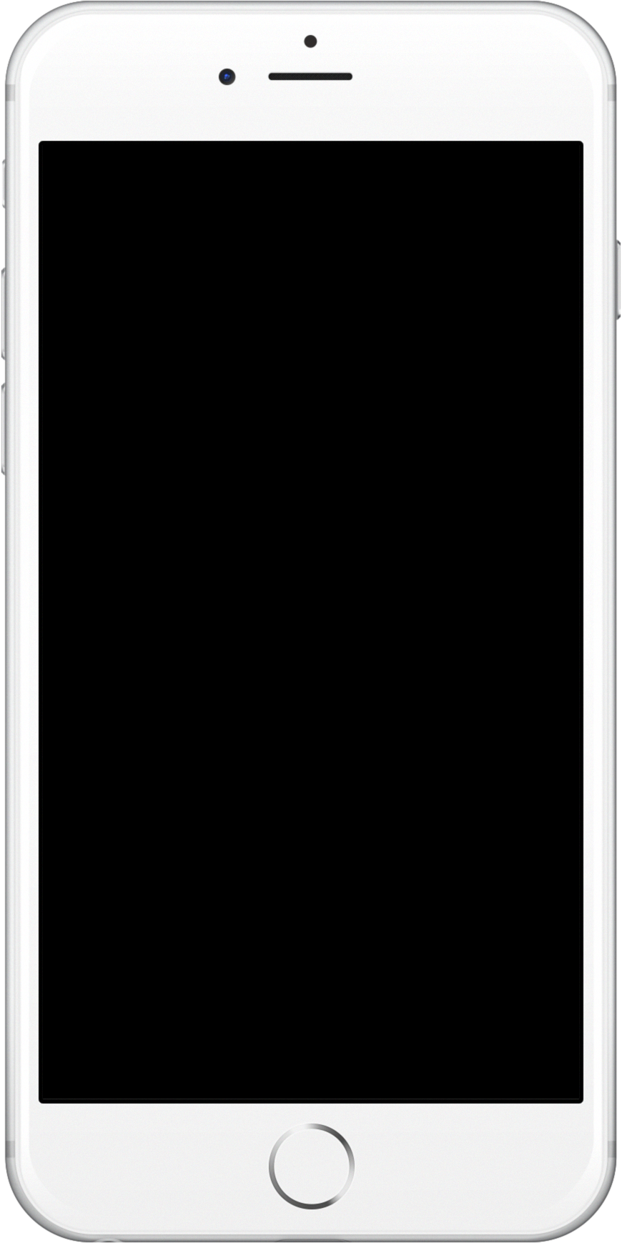





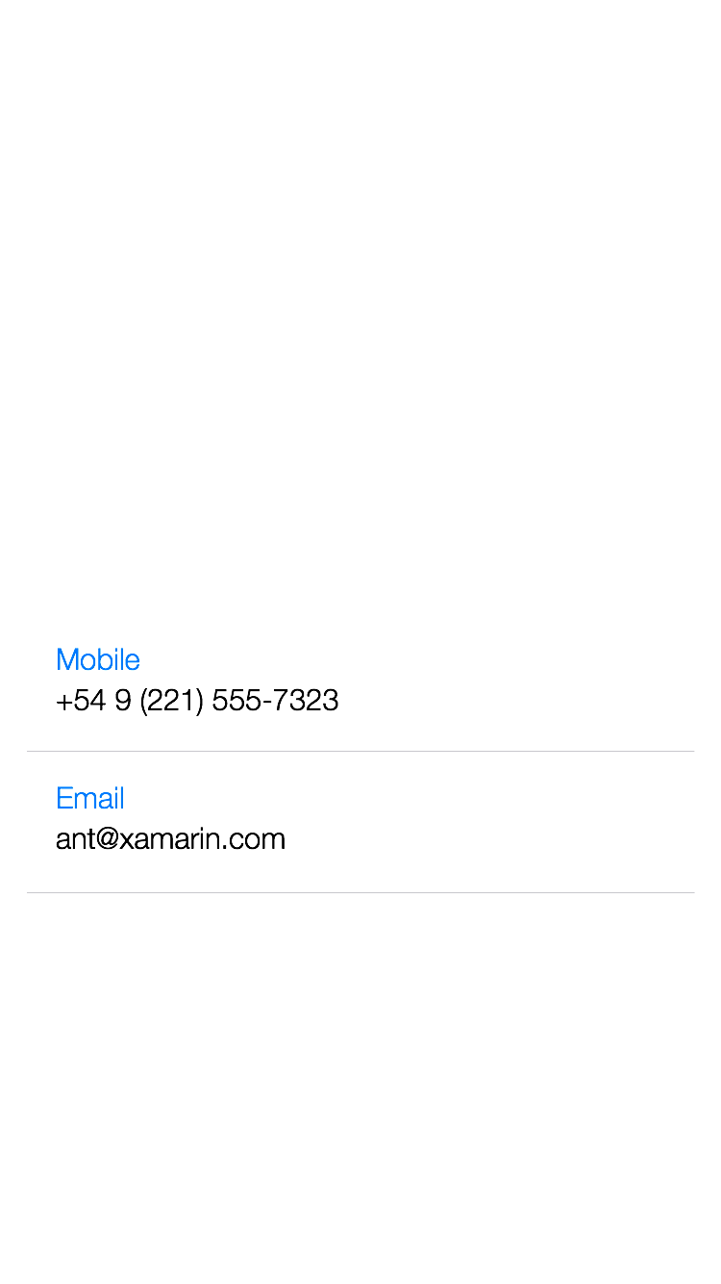





UI view hierarchy
Notes:
Structure of UIElements in an App
It’s arranged like a hierarchy
The UI is made up of different layers, each layer holds different elements
This creates a tree-like structure that you have to navigate up or down levels to reach specific elements

Slide 6
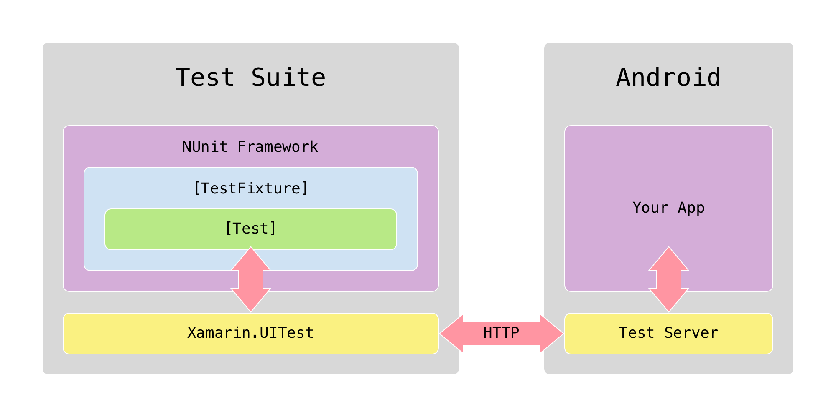
Communication with an Android app
Notes:
How UITest works: Android:
The Test Suite is written in C# and executed using the popular NUnit testing library.
Xamarin.UITest is the Automation Library that allows the NUnit tests to execute on Android and iOS devices.
The Test Server (Xamarin Test Cloud Agent) is a middle man that will take queries (and in some cases, actions) from the tests and perform them on the application being tested.
In Android, the Test Server is responsible for using the Android automation APIs to control the user interface and to locate views so that a test can interact with them. It is bundled into a separate APK and runs as a separate application, which has permission to automate the application under test.
The Test Server is a lightweight HTTP server that interacts with tests via JSON over HTTP.

Slide 7
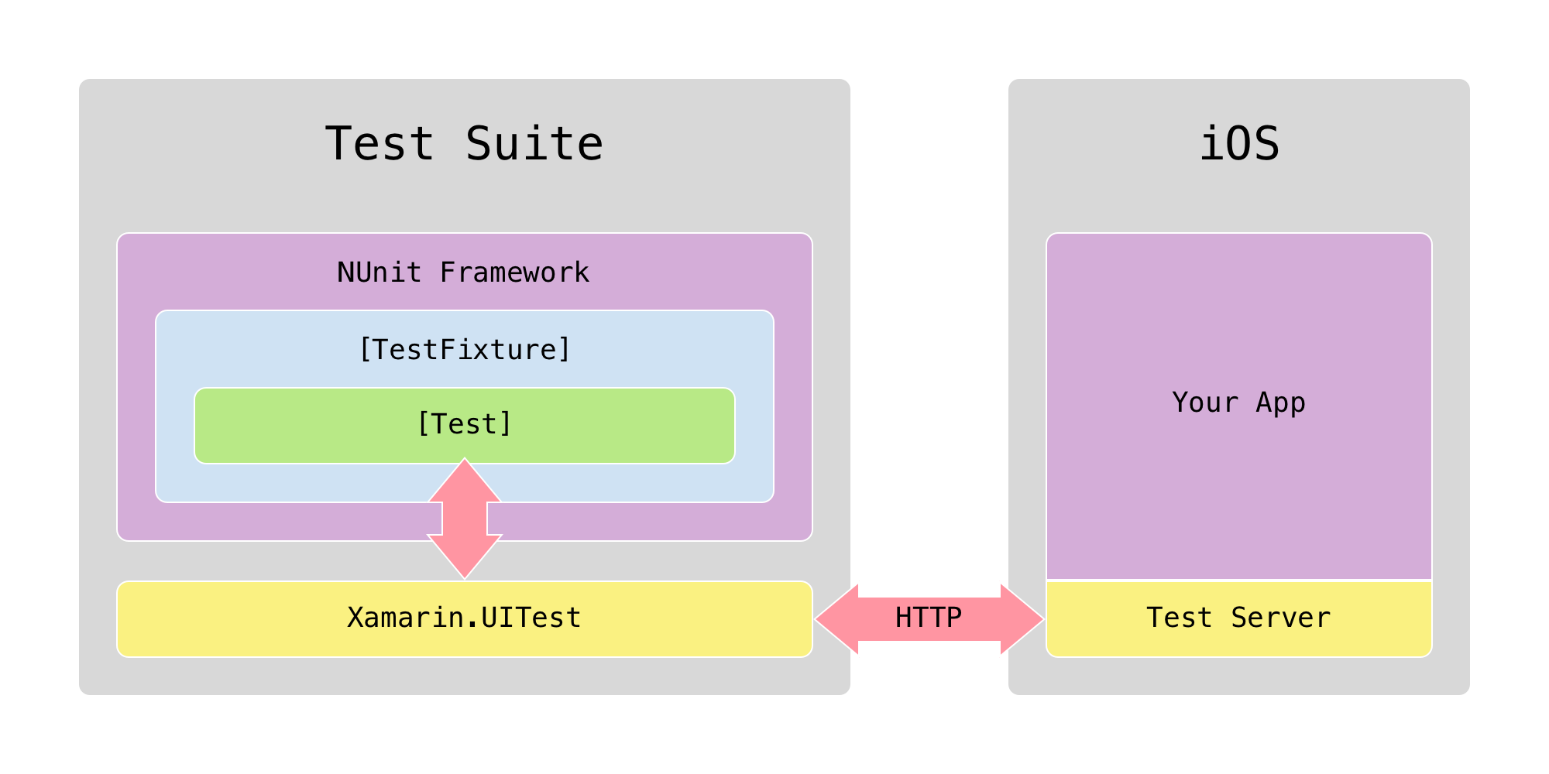
Communication with an iOS app
Notes:
How UITest Works:
iOS:
The Test Server (Xamarin Test Cloud Agent) works slightly different in iOS
The Test Server sits inside the app and acts as the middle man providing information about the current active window and the views
The test script uses the information from the Test Server and automates the iOS application with the help of another component called the DeviceAgent.
The DeviceAgent simulates the gestures and actions for the test using the automation APIs provided with Xcode.

Slide 8
Anatomy of a UI test
[TestFixture] public class Tests { [SetUp] public void BeforeEachTest() { // Set up app } [Test] public void LogInTest() { app.Tap(x => x.Id("log-in-button")); // ... } }
Notes:
A simple test that uses NUnit as the test runner
NUnit attributes
TestFixture: defines a group of tests and is added to the class that contains test methods
SetUp: is added to a method that you want to run before each test method to prepare the app. This is where you launch the app and initialize any variables that you will need in your tests.
Test: defines a test method. This is where you write the code specific to a certain test that you want to write. The name of this method will show up in the test runner and test reports.

Slide 9
Finding elements on the screen
app.Repl()
Opens terminal interaction with app
tree
Prints UI visual hierarchy
app.Query()
Gets a list of all the elements on the screen
app.Query(x => x.Class("Button"))
Elements of the specified type
app.Query(x => x.Text("Log in"))
Elements with the specified text
app.Query(x => x.Class("Button").Text("Log in"))
Elements of the specified type that also have the specified text
app.Query(x => x.Id("LogInButton"))
Elements with the specified ID
This is the best method to use to locate an element
Notes:
Examples of different ways to locate an element on the screen by “filtering down” the list of all visible elements to just the one(s) you are interested in.

Slide 10
How to interact with an app’s UI
app.Tap(x => x…)
Tap the specified element
app.EnterText("some text")
Enter the specified text on the keyboard
app.WaitForElement(x => x…)
Wait for the specified element to appear on the screen
app.ScrollDownTo(x => x…)
Scroll down until the specified element appears on the screen
app.Screenshot("some description")
Take a screenshot for the Test Cloud report
Notes:
There are many more methods as well
Screenshot is important in the cloud
REPL is important for writing your tests

Slide 11
Demo: Explore the MCWeather app in the REPL
Notes:
Add app.Repl() in one of the tests and show them how to launch the REPL
Demo :
Tree Command
app.Query()
The lambda statement
The different Query options: Class, ID, Text
Example of how to compo

Slide 12
Exercise 1: Make your own first test
Create a test called WeatherLocationTest that has the following steps
Select a city specified by the test code
Verify the temperature is displayed
Bonus: Write a test for saving a city to your Favorites
Notes:
Exercise, repeat steps shown in the previous demo
Open REPL
Query for Get Weather button
Query for Text box
Enter text into the Location text box
Gesture Interact with the Button element
Copy steps
Paste into Test.cs file
Edit into Method called WeatherLocationTest()
RUN TEST!

Slide 13
WebView queries
Applications often contain an embedded WebView, or may be entirely web-based (e.g. Cordova and PhoneGap)
Elements can be located using their CSS selector
# corresponds to an element’s ID
. corresponds to an element’s class
Example:
app.Query(x => x.Css("#some_id"));

Slide 14
Invoke a control’s methods
Invoking a control’s methods directly can often help if you are having trouble manipulating the control via Xamarin.UITest e.g. selecting a value in a UIPickerView or NumberPicker
app.Query(x => x.Class("UIPickerView") .Invoke("selectRow", 2017, "inComponent", 2, "animated", true));
app.Query(x => x.Class("NumberPicker") .Invoke("updateDate", 2017, 0, 14));
Note: you may still need to tap the row to get the UI event to fire
Methods and parameters can be found in API documentation
https://developer.android.com/reference
https://developer.apple.com/reference

Slide 15
Backdoor methods
Backdoor methods are methods in the application code that can be invoked during tests
Perform some special action to configure or set up the testing state of the device
Saves time during tests, especially if the backdoor provides functionality that would be repeated during the UITests, such as signing into an app.
Common examples of backdoor methods include:
Signing in to the app without manipulating the UI
Seeding a database before the test run

Slide 16
Defining backdoor methods – Android
Defined in an Application subclass, Activity, or Context of root view
Decorated with Java.Interop.Export attribute, with the name of the backdoor method
[Activity(MainLauncher = true)] public class MainActivity : Activity { [Export(”myBackdoorMethod")] public void MyBackdoorMethod() { // In through the backdoor - do some work. } }

Slide 17
Defining backdoor methods - iOS
Defined in the AppDelegate
Decorated with the Export attribute, with the name of the backdoor method appended with a colon :
[Register("AppDelegate")] public class AppDelegate : UIApplicationDelegate { [Export("myBackdoorMethod:")] public NSString MyBackdoorMethod(NSString value) { // In through the backdoor - do some work. } }

Slide 18

Invoking backdoor methods
Backdoors are invoked in UITest code by calling the IApp.Invoke method
Parameters can be passed to the backdoor with the Invoke method
[Test] public void InvokeTest() { if (OnAndroid) app.Invoke("myBackdoorMethod", "some value"); if (OniOS) app.Invoke("myBackdoorMethod:", "some value"); }
For more information, see https://developer.xamarin.com/guides/testcloud/uitest/working-with/backdoors/

Slide 19
Exercise 2: Write and consume backdoor methods
Write a backdoor method in MainActivity and AppDelegate that seeds the Favorite City database with new cities
Invoke the backdoor methods at the start of a new test
Assert the favorite cities list displays the data used in the backdoor method

Slide 20
Common pitfalls
Make sure the Xamarin.UITest NuGet package is up to date
NUnit 3 is not yet supported in Test Cloud
No IDs on UI elements will make it harder to write stable tests
Specify the withinQuery parameter of scrolling methods
Don’t use Android mono shared runtime
Make sure to include the Calabash Test Server in the iOS app
#if DEBUG Xamarin.Calabash.Start(); #endif
Notes:
No IDs on UI elements will make it harder to write stable tests
Apps can have multiple elements with the same text, language settings can translate texts, and view hierarchy indexes can change but ID’s are generally unique.
Forms apps can map AutomationId to Content Description and ID in Android and iOS, respectively
Documentation on adding IDs in Xamarin.Forms applications: https://developer.xamarin.com/guides/xamarin-forms/deployment,_testing,_and_metrics/uitest-and-test-cloud/
Make sure to include the Calabash Test Server in the iOS app
If Xamarin App: include the Xamarin Test Cloud Agent NuGet package
Call Xamarin.Calabash.Start() in AppDelegate.FinishedLaunching to start it. Make sure to conditionally compile so it's linked out for release builds.
For apps built with the native tools, use this guide: https://github.com/calabash/calabash-ios/wiki/Tutorial%3A-How-to-add-Calabash-to-Xcode
Don’t use Android mono shared runtime
UITest cannot run on apps using the Mono Shared Runtime, so for test builds this will need to be turned off. This can be set in the project options menu
Make sure the Xamarin.UITest NuGet package is up to date
Since OSs change quickly and we're dealing with multiple, it is important to make sure the package is kept up-to-date.
This is generally the first thing I ask if someone is seeing issues with test execution
NUnit 3.x is not supported in Test Cloud right now
Currently only up to NUnit 2.6.4 works in Test Cloud. This should change in the future, but it is the current status
Not specifying the withinQuery parameter of scrolling methods
This can increase speeds of methods. If not specified, UITest will use the top-most ScrollView

Slide 21
Test suite architecture: Page object pattern

Slide 22
The page object pattern (POP)
What?
Each page in your app is modeled by a class in your test project
Page representations handle all interaction with their target page
This simplifies test methods down to just calling methods on pages
Why?
It’s intuitive and easy to implement
Good separation of responsibility
Also makes it fairly easy to do cross-platform tests as long as pages are similar between platforms

Slide 23
Page object pattern rules
Each page in the app is a class in your test code
One-to-one mapping
Page representations know about all the elements on that page
Page classes save queries for all the elements on the page as fields at the top of the file
Page classes define methods for all the actions that can be taken on that page
There is no “procedural” code in test methods, only in page methods
Test methods consist only of calls to page methods

Slide 24
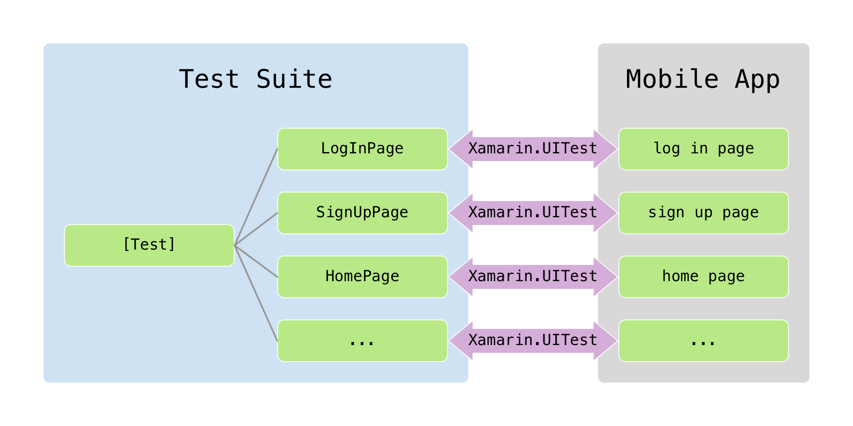
Page object architecture
Notes:
Note one to one relationship between page classes and pages in the app.
UITest bridges gap between test and app. Only Page classes interact with actual pages via UITest.
The test only knows about the page classes. It has no relationship to the actual page in the app.

Slide 25
Test using the page object pattern
[TestFixture] public class Tests { [SetUp] public void BeforeEachTest() { // Set up app } [Test] public void LogInTest() { } }
new LogInPage().LogIn("user", "password");
app.Tap(x => x.Id("log-in-button"));
Notes:
The example we looked at earlier is actually not entirely correct because the test is making calls to UITest directly (the ”app…”). We should replace this “procedural” code in the test with calls to page classes instead.

Slide 26
Demo: Sample page object pattern test suite
Notes:
AppManager.cs
Launches app based on the platform we are on
Initialized the “app” variable and saves a static reference to it so that other pages can access it easily
BaseTestFixture.cs
A common class for all your test fixtures to inherit from
Holds a shared SetUp method
PlatformQuery.cs
This contains traits per platform
ForecastTests.cs
Inherits from BaseTestFixture
It’s a test fixture that can contain several test methods
The test never calls “app.”
The test only consists of calls to pages. The pages do all the work of interacting with the app and make the test easy to understand at a glance.
BasePage.cs
All pages inherit from BasePage
When the BasePage’s constructor is called it waits for a “trait”
Each page defines it’s own trait, which is a an element that is unique to that page and indicates the page is fully loaded and ready to interact with.
ForecastPage.cs
Inherits from BasePage
Overrides the Trait property of the BasePage with the identifiers for the page
Sets all the queries for elements on the page in the constructor so it is easy to change the queries if the app ever changes
Implements methods for actions that can be taken on that page
WeatherPage.cs
The WeatherPage has several unimplemented methods that need to be completed (this is the exercise for this module)

Slide 27
Exercise 3: Refactor to page object pattern
Add the Xamarin.UITest.POP NuGet package to the solution
Edit AppManager.StartApp so that the calls to ConfigureApp point to the appropriate app binaries
Rename Tests to WeatherTests and ensure the class inherits from BaseTestFixture
Move the procedural code from your tests into new classes named WeatherListPage and WeatherDetailPage that inherits from BasePage
In your tests, call the methods from WeatherListPage and WeatherDetailPage

Slide 28
Recommendations: When to use the page object pattern
Always use the page object pattern unless you are only going to write one or two quick tests.
It works best for apps where iOS and Android versions have similar flow and views
If the UI and/or app flow is markedly different, we recommend writing separate tests per platform (but still using the page object pattern)
For more information about the page object pattern and an example test, see
https://github.com/xamarin-automation-service/uitest-pop-example
For even more information about the page object pattern, including screen shots and descriptions, see the appendix.
Notes:
The best fit for these kinds of tests is if the UI for Android and iOS are very similar with corresponding views. A lot of apps look somewhat similar on different platforms, but, in practice, have very different flows.
If the apps are really different then it might not make sense to write cross platform tests because of all the branching you would need to do to account for the different behavior. In that case you will want to set up separate tests.
However, in our experience, most apps are similar enough that you can write one cross platform test suite.

Slide 29
A few other general UI test best practices
Split tests into small chunks wherever possible
Use backdoors to avoid repetition
Make each test self contained
Independent tests that start with a clean state
Be as deterministic as possible
Use backdoors to set up the app
Avoid branching on UI state
Avoid branching in general (if, else and try, catch)
Use assertions (WaitForElement, WaitForNoElement, and Assert)
Take many screenshots
Try not to do anything randomly
Try not to use Thread.Sleep
Be careful with loops, especially the while loop
Notes:
Use backdoors to avoid repetition
Use backdoor methods to put the app in a particular "clean" state before each test and to navigate quickly to the area being tested. If reaching a certain app state is time consuming, backdoor methods can provide a useful alternative.
E.g. you don’t need to automate logging in every time, or getting the app to some state with non-persistent data.
Documentation on backdoors: https://developer.xamarin.com/guides/testcloud/uitest/working-with/backdoors/
Use backdoors to set up the app
Backdoors can also create a consistent app state so that every test starts with a clean slate.
Avoid branching on UI state
Your test should expect a certain UI state and assert that it is as expected rather than querying the UI to determine the next step.
Avoid branching in general (if, else and try, catch)
These are warning signs that you are not being as deterministic as you could be.
They can be useful in certain situations, but be conscious about whether or not you can use an assertion instead.
Use assertions (WaitForElement, WaitForNoElement, and Assert)
We write tests to confirm app behavior, assertions are essential to confirm conditions.
Best practice would be to assert following every action.
Take many screenshots
In Test Cloud, screenshots are the best way to see every step of a test's execution and visually identify bugs.
Best practice would be to take a screenshot following every assertion (i.e. do some action, make assertion, take screenshot).
Try not to do anything randomly
Test results should be repeatable between test runs, randomness inherently takes this away.
Try not to use Thread.Sleep
WaitForElement and related methods provide a much better alternative.
The only exception to this rule is when you have an animation that needs to complete before you want to interact with any elements.
Be careful with loops, especially the while loop
Make sure you don't have loops that will run forever if something goes wrong with your app.
Limit them to a reasonable number of iterations so that if something unexpected happens, youdon’t waste execution time in the cloud.

Slide 30
Test Cloud

Slide 31
Demo: Test Recorder
Notes:
Demo : (Either VS Extension or Mac app) Record simple test (similar to one in the first simple test demo) and replay

Slide 32
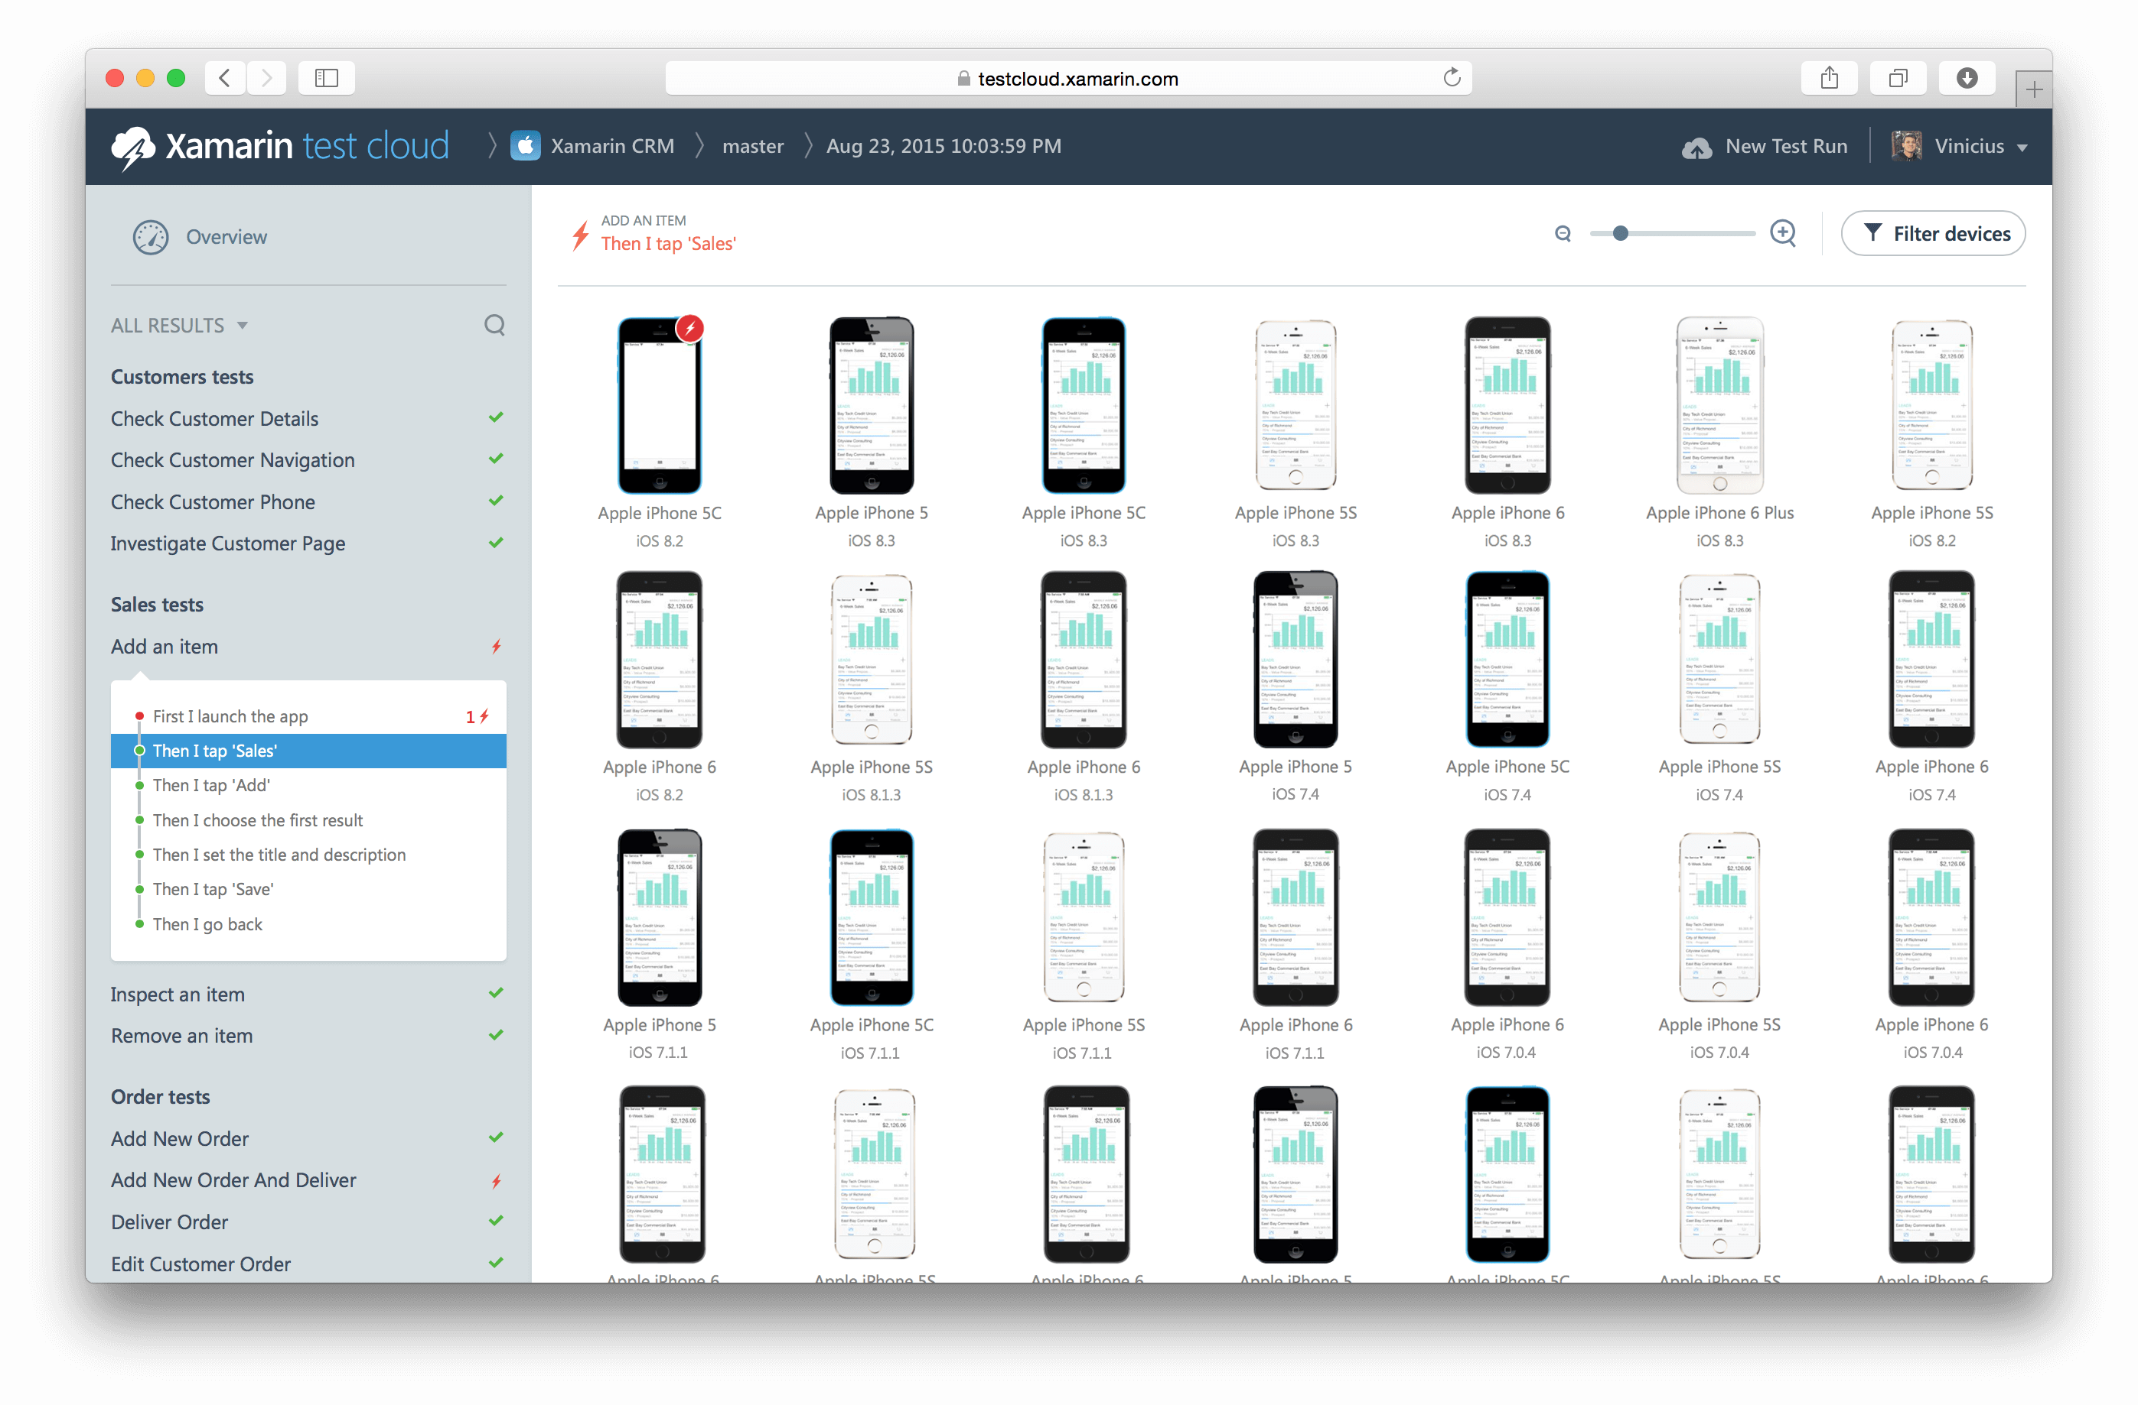
Testing on real devices
Notes:
Why would we want to upload to Test Cloud?
Get to see our app running on as many devices as we want
Get the results back much quicker than running on several local devices
See a well formatted report that makes troubleshooting issues easy
You can kick your tests off from CI and get reports back every day so you can quickly see if anything starts breaking

Slide 33
Demo: Walk through a sample Test Cloud report
Notes:
Sample Test Cloud report:
https://testcloud.xamarin.com/test/xamarin-crm_1bde07cc-0686-4e8d-9c31-ada1e37cd4e6/
Overview charts and stats
Test failure rates, device failure rates
Device time, run time, devices, etc.
Failures by category, failures by device
Memory usage
Test results layout and stepping through screenshots
Test fixture in bold, with tests underneath
Choose a test to see each step (screenshot) in that test
You can see what that step looked like on several devices at once
Choose a device to get more detail (logs, memory/CPU usage, etc.)
Investigating a failure and finding bugs in the app
Choose a failing test
Go down to the failing step
Choose a failing device and look at the test failure
The screenshot combined with the test failure should give you enough info to troubleshoot the failure

Slide 34
Command line parameters
--devices
Hash code for set of devices
--series
The destination “folder” for this test run in Test Cloud
--locale
Two letter language code with two letter country code in the format [language]_[country], for example, EN_US.
--user
The email address associated with your account
--assembly-dir
Path to the folder containing your compiled test DLL files
Notes:
Required for every upload

Slide 35
Optional parameters
--dsym
iOS debug symbols file to improve stack traces
--include
Filter the uploaded tests based on their category
--fixture
Specify a specific test or fixture to upload
--async
Don’t wait for test execution to complete (doesn’t require a parameter)
--test-params screencapture:true
Records a video of the test (on Android only)
Notes:
Documentation Link Uploading to Test Cloud by command line : https://developer.xamarin.com/guides/testcloud/uitest/working-with/submitting-tests-at-command-line/#Submitting_UITests

Slide 36
Exercise 4: Try Xamarin Test Cloud
Upload MCWeather.UITests to Test Cloud using the command line
Bonus: Enable screen recording for Android tests

Slide 37

Other Test Cloud frameworks supported
Appium | Espresso | XCUITest
Android and iOS Tests written in Java, executed by JUnit (other language support coming) Open source, sponsored by Sauce Labs | Android only Tests written in Java or Kotlin, executed by Android Junit Developed by Google | iOS only Tests written in Objective-C or Swift, executed by xctest Developed by Apple
Notes:
Espresso/Appium support is in public preview

Slide 38
Test Cloud frameworks support
Xamarin.UITest
Greenfield development
Easy setup
Leverage C# experience
Integration into XS/VS
Appium, Espresso, or XCUITest
Existing tests written with one of these frameworks
Strong need to use a language other than C#
Keep in mind that Espresso is only for Android and XCUITest is only for iOS. Don’t choose either of these frameworks if you want a cross-platform test suite
Still use page object pattern

Slide 39
DevOps

Slide 40
Deployment
Decision
Action
Enterprise or App Store?
The idea of deployment is simple, but with each decision, actions need to be accounted for related to:
Provisioning
Certificates
DRM
Security
etc.
Enterprise
App Store
Release or beta?
Release or beta?
Release
Beta
Beta
In App Store?
Release
iOS App Store
HockeyApp
App Store
Google Play
Yes
No
Custom
iOS App Store
HockeyApp
HockeyApp
MSFT Store
Other(s)
Google Play
Custom
MOM
Amazon App Store
MSFT Store phone only
Other(s)
Custom
Custom
Notes:
There is a lot of work involved in building and deploying an app. We want to automate that as much as possible.
Types of variable to be accounted for based on the decisions taken
Sign in certificates of the various code bases and in the variety of stores (Enterprise)
If it is apple you need theirs
If you are doing windows you need one from a third party.
Android you can do a self-generated certificate
If doing a Beta
Universal device identifiers for beta for all devices.
If in App stores
DRM license protection.
If Apple they care of it.
If you are doing Android you need to get theirs
If you are going into other app stores you need still different ones
They will be Different every time
Amazon lays their own license management on your app.
This goes on and on and it all must be accounted for.
In development—not everything will be done. But knowing what to ask about is crucial

Slide 41
Benefits of continuous delivery
One click deploys to multiple environments
Configurable through the CI server, which offloads the work from engineers
Testing
CI solutions offer steps for deploying to specific platforms, but requires configuration
Provisioning profiles
Certificates
etc.
Fast lane for iOS end-to-end automation
https://fastlane.tools
Informing the business
Notes:
It really helps to offload the whole process of deployment from the engineers so that they can focus primarily on development because once these things have been set up, it can be as easy as a clicking a button to deploy.
It’s a very common scenario to have designers or product owners wanting to know what the latest build is looking like. If it wasn’t for CI and CD, they would be constantly pestering the developers to create a new build for them and install it on their device so they would be wanting you to plug in your device into their local machine—stop what you’re doing, do a build, and then put it on their device.
The major benefit of CD and HockeyApp is that they can literally check for the latest build and download it themselves at all times because the latest build is always available for them to download.

Slide 42











Continuous delivery
Source code
Version control
Build server
Testing
Deploy
Developer
Feedback
Analytics
Bugs
Users
Notes:
The software development practice in which an automated build compiles and optionally tests an app when code is added or changed by developers in the project's version control repository.
TestFlight and HockeyApp are two options that allow you to have continuous app delivery.
The CI solutions we discussed can all integrate with these continuous delivery tools to deliver the code or the app itself continuously.

Slide 43
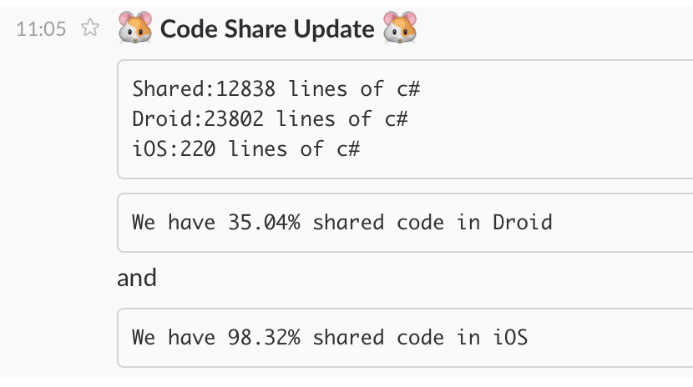
Feedback
Integration with several mediums to output CI operational results
Broken build notification
Performance metrics
Anything!
Notes:
An important factor of CI is the output because CI is not useful if you don’t have a way of getting immediate feedback to the team based on the results, such as the build is broken, a unit test failed, or the UI test failed. You need some form of output to the team.
Adding a build dashboard is a good idea. (For example, Jenkins has a good UI that gives you information about the history of broken and successful builds so that you can roll back more easily.)
A dashboard typically offers a traffic light-type system that shows the current state of all of your various builds because you might have multiple build types (for example, different platforms) building independently. The dashboard lets you see the state of the iOS build, the Android build, and so on simultaneously and at all times.

Slide 44
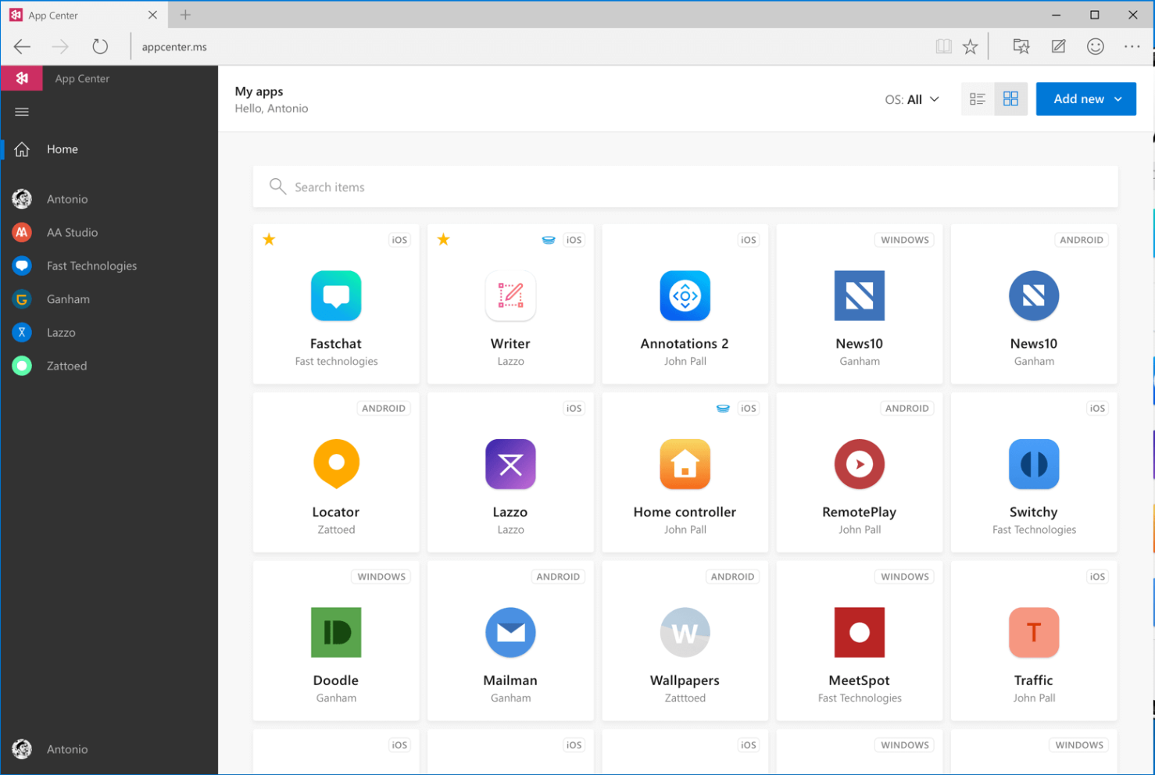
Visual Studio App Center
Continuously build, test, release, and monitor apps for every platform.
VSTS, Test Cloud, HockeyApp, Azure Mobile Services in one place
Testing does not differ from Test Cloud
Push notifications and crash reporting features are still in preview
For more information, see: https://appcenter.ms/

Slide 45

Continuous integration and source control offerings
CI solutions
Source control options
Notes:
A variety of CI solutions exist.
Jenkins is very popular as is TeamCity.
You can run a CI solution with almost any source control offering but it’s a good idea to check for compatibility. Jenkins will run with any of them.
Visual Studio Team System (VSTS) probably won’t work with Subversion.
Source control mechanisms are general independent and should generally support any of the CI solutions via a plug-in.

Slide 46
Build your own agents
macOS for iOS builds
macOS or Windows for Android
Windows for UWP
Steps:
Install platform SDK (i.e. Xcode, Google, etc.)
Install Xamarin
Install agent software for the CI server
Install certificates
Install provisioning profiles
Notes:
What build agent you’ll need and where it needs to point to build certain things.
Obviously, you can only build iOS applications through MacOS (formerly OSX).
For Android, you can use MacOS or Windows.
For Windows phone, you use Windows.
In terms of setup steps, you need to:
Install the platform SDK specific to the platform you’re using
Install Xamarin
Install the agent software for the CI server
Essentially a common way for an automated process to kick off commands

Slide 47
Scripting build steps
You could sequence each build task
Compile
Package
Test
Upload to HockeyApp
…
Much better to have a build script
Runnable from anywhere
Easily reusable on different machines and different projects

Slide 48

Example Cake script
var target = Argument<string>("target", "Default"); Task("Restore-NuGet-Packages") .Does(() => { NuGetRestore("./MySolution.sln"); }); Task("Build-iOS") .IsDependentOn("Restore-NuGet-Packages") .IsDependentOn("Clean-iOS") .Does(() => { DotNetBuild("./MyProject.iOS/MyProject.csproj", settings => settings .SetConfiguration("Release") .WithProperty("Platform", "iPhone") .WithProperty("OutputPath", "bin/iPhone/Release/")); });
Notes:
A lot of this can be handled within the CI service itself using its UI or you can write the build scripts yourself
Along with building the app itself (continuous integration builds the app continuously) as people check in, the CI server will commonly have some kind of integration, perhaps through email, so that it can, for example, blame someone for a broken build.
Another important thing to remember is that the CI server can also perform unit tests regularly or continuously or UI tests and code coverage. As you’re developing code and checking things is, it can handle all of these things and provide a decent amount of feedback throughout the development process so that you don’t go weeks and then run a unit test and discover that things are broken or you have some sort of regression.
Another thing you have to consider because Xamarin studio handles it for you through a build process is that packages and components will need to be restored as well because in order to be able to build these things, they will need to be restored and updated depending on what’s been done on the project.

Slide 49
Build/CI
Best Practices:
Use the build/CI server to inject keys and tokens to avoid having them in the source code control.
Only publish builds that have been generated by your build/CI server.
Common Pitfalls:
Provisioning profiles and/or certificates not installed on build agent.
Version of Xamarin on your build server different than on your development machine.
Android SDK on your build server out of date.
Xcode out of date on your build server.

Slide 50
Exercise 5: Automate build and test process
Complete the missing fields in build.cake
Automate the building and testing of IPA and APK files.
Bonus: Add a build step to deploy to HockeyApp after successful Test Cloud tests

Slide 51
Q & A

Slide 53
Appendix

Slide 54
Things to be aware of as you write your tests
Upload additional files to Xamarin Test Cloud
For example, a CSV with multiple logins
Notifications
Test server will automatically dismiss OS notifications
Tests need to dismiss app-implemented alerts
Invoking a control’s methods directly can often help if you are having trouble manipulating it via UITest.
app.Query(x => x.Id("slider").Invoke("setValue", 10));
Notes:
Upload additional files to Test Cloud
You may want to include other files with submission (e.g. a csv with multiple login info).
To do so, include it as embedded resource in Test solution, and pull info out of the assembly as needed.
Notifications
Android and iOS system notifications should be dismissed by the runtime of the tests automatically.
App implemented alerts will need to be dismissed through the tests.
Invoking native UI methods on elements
Doesn’t simulate actual user interaction perfectly, but can be useful in certain situations
This can be especially useful to use instead of scrolling with UIPickerViews and UISliders
First locate the element in a query, then append .Invoke(“theMethod”, “firstParameter”, …) to the query to make the call on the native object
E.g. use the setValue method of a UISlider elements instead of dragging coordinates
app.Query(x => x.Id("slider").Invoke("setValue", 10))

Slide 55
Screenshots and descriptions of Xamarin Test Cloud actions

Slide 56
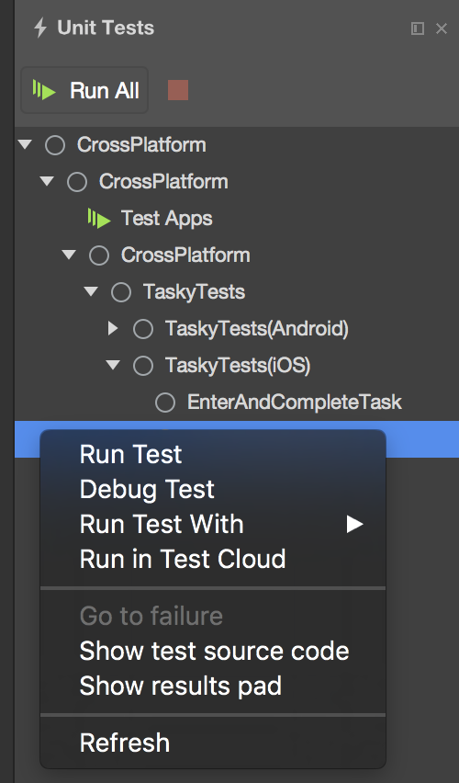
Starting Xamarin Test Cloud
There are two methods to start Xamarin Test Cloud
The easiest is from Xamarin Studio or Visual Studio
Go to Unit Test Pad, right-click the test, and then click “Run in Test Cloud”
It will go through an upload process and bring you to a web browser where you can select the devices you want to test.
This is simple but not very powerful
Second, from the command line
Much more powerful than the IDE upload, but a bit more work
This is the method you would use in CI

Slide 57
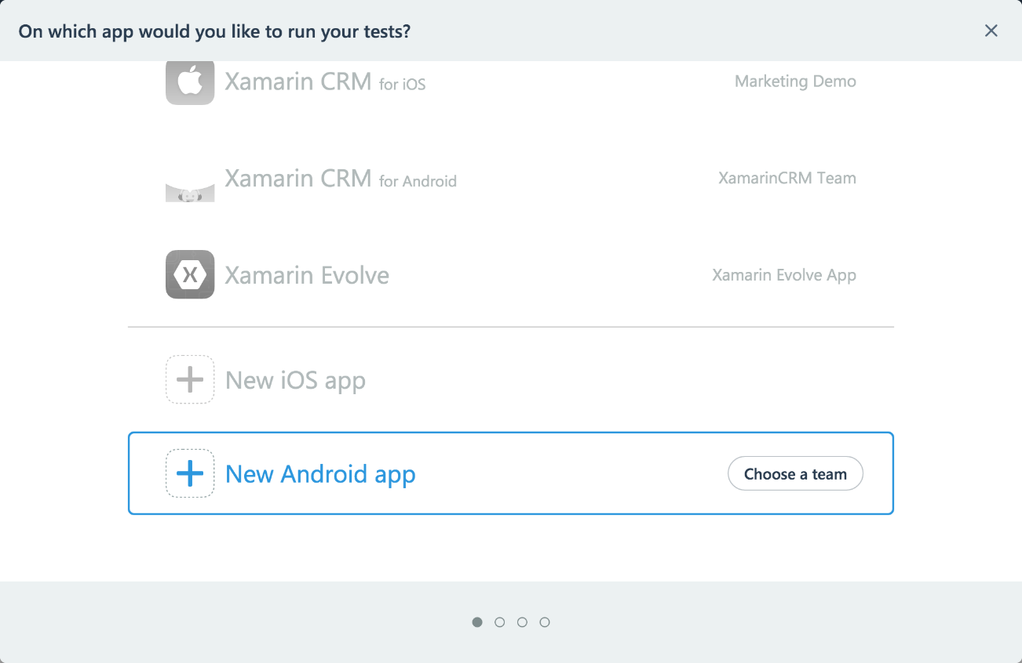
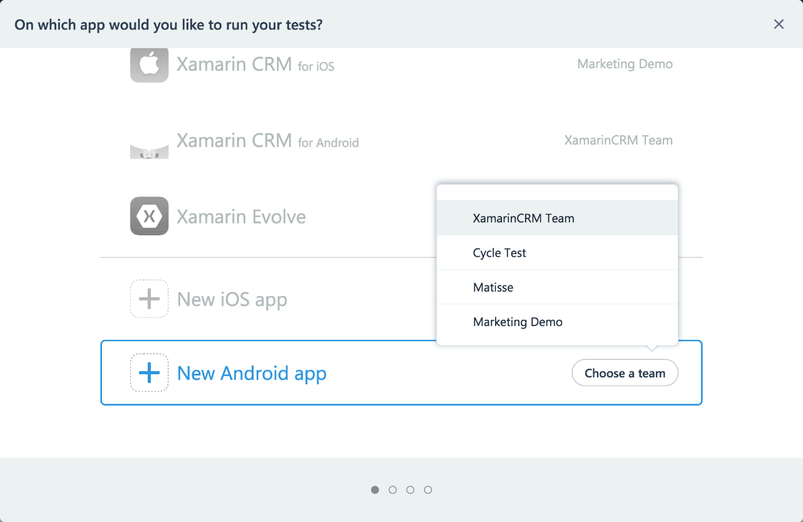
Uploading a new app to Test Cloud
If you are going to be implementing a CI system or CI server, save the upload command to simplify those operations
1. start with a new test run in the test cloud portal
2. Choose your team and app

Slide 58
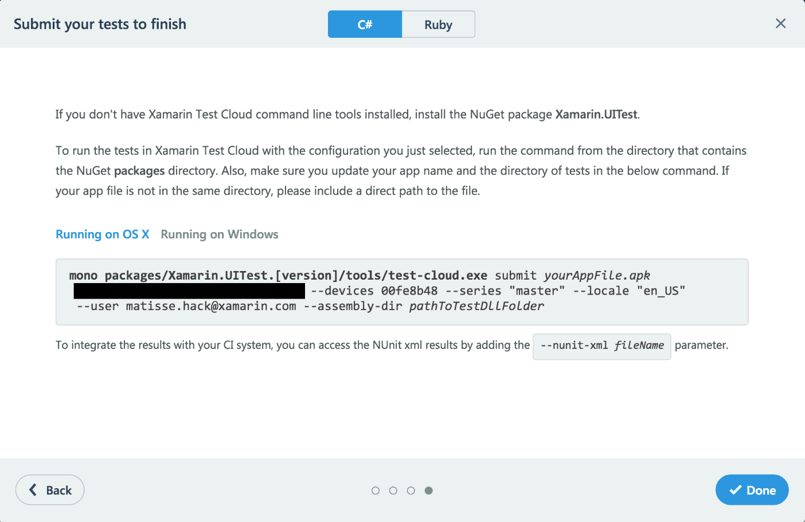
Using the generated command line
The blocked out text is your API KEY, which is unique to your team. This key will remain constant on all our test runs.
The device’s hash code will always link back to the same selection of devices you specified in the previous steps. You can reuse this across different runs of your test.
You will need to fill in “[version]”, “yourAppFile.apk”, and “pathToTestDLLFolder” with the appropriate version of UITest and appropriate paths

Slide 59
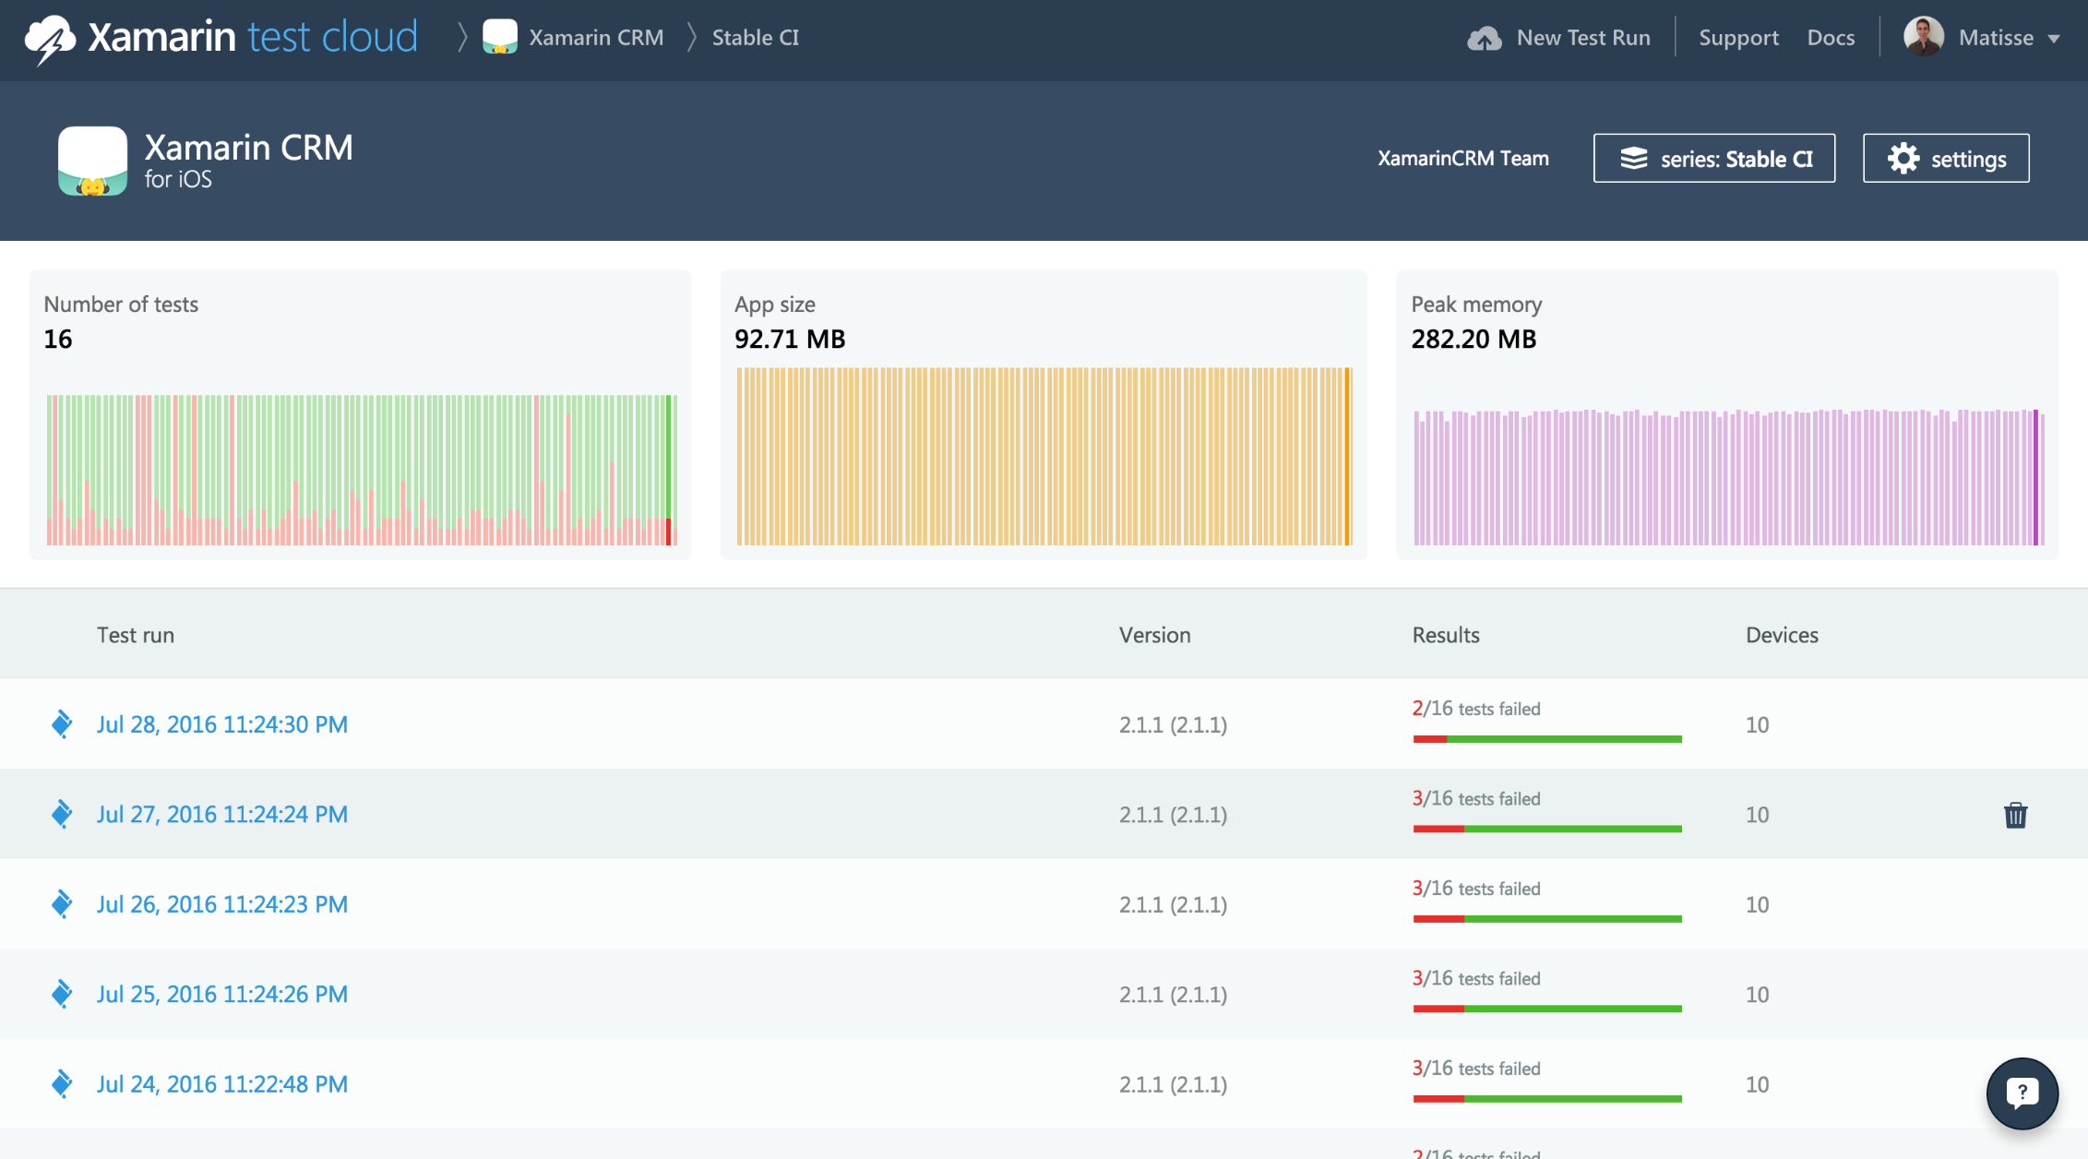
Test series overview with historical data

Slide 60
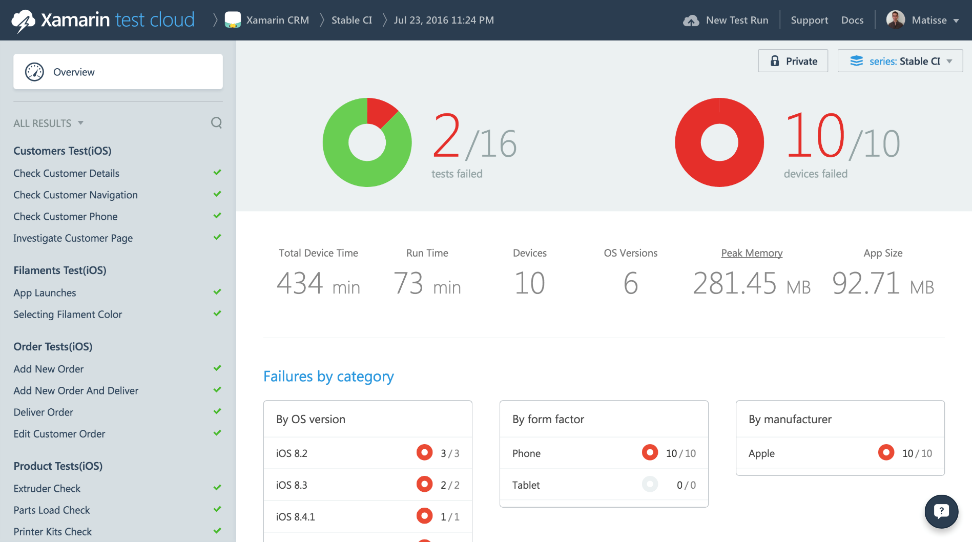
Xamarin Test Cloud UI
Number of tests
that failed
Number of devices that failed tests
Tests grouped by fixture
Test execution details
Breakdown of failure rates
Notes:
Shows on the left above overall breakdowns of the tests on your devices
Of the 16 tests two failed. On the right every device had a failure.
Shows breakdown of total device time and run time of the test.
Shows the total amount of test time on each device. If you have a 30 minute test on two devices that will be 60 minutes of device time

Slide 61
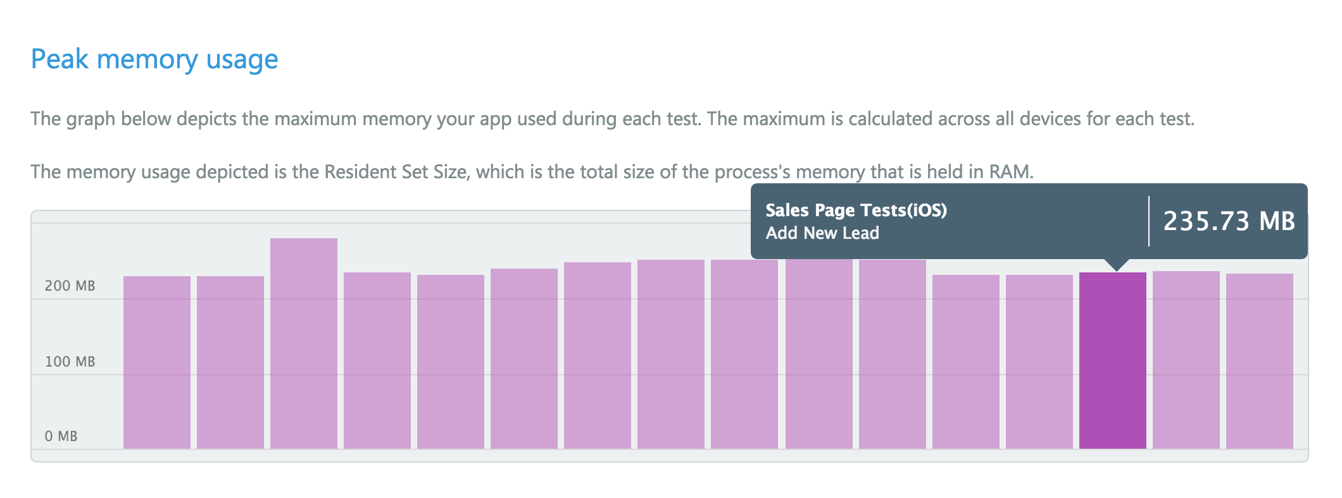
Peak memory usage record in the UI
Peak memory usage shows the maximum memory the app used during each test

Slide 62
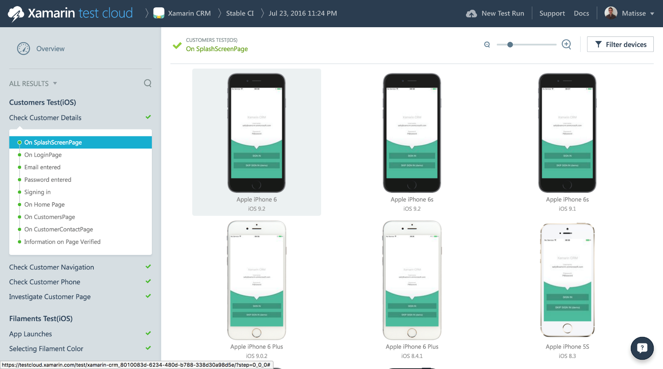
Test layout
Fixture
Test
Steps
Screenshots for each device

Slide 63
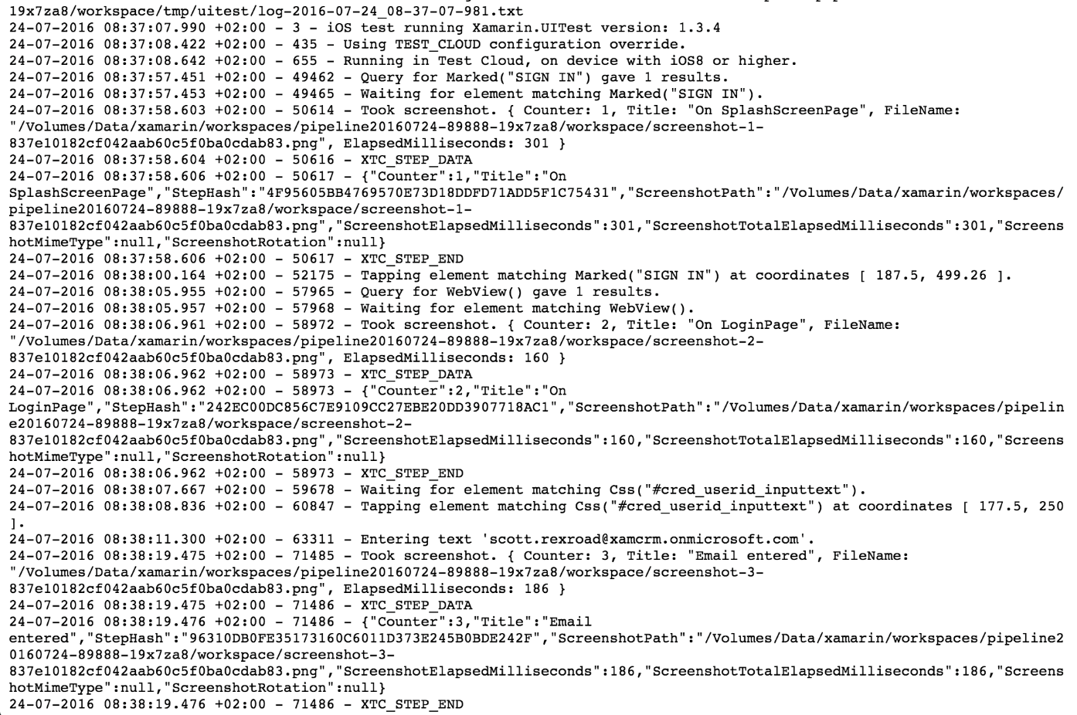
Full device & test logs are available
Obviously dense with information, but can give you insight into why something failed

Slide 64
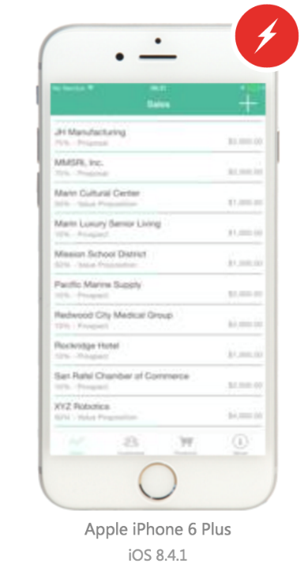
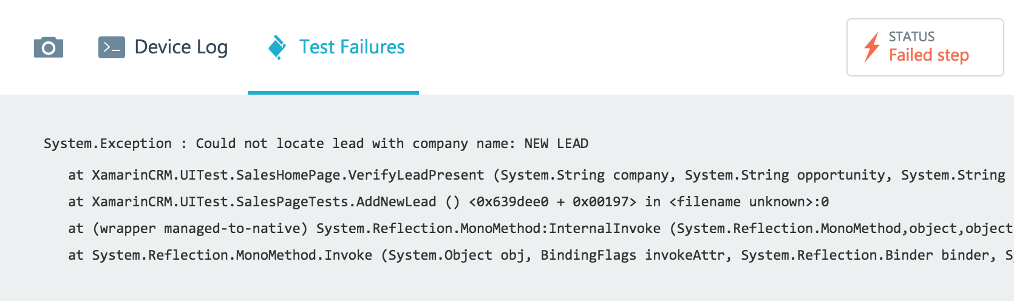
Another example showing a failure
This failure is due to our newly created lead not showing in the list when we are done. This is an example of Test Cloud discovering an error that is deeper than UI bugs.
Here you can see the failure message for this step of the test
good example of why you want to use descriptive language in your error messages
Notes:
This slide shows another failure, in which a lead was never added to the list of leads.

Slide 66
Additional resources
Thing 1
Thing 2
Thing 2

